Slide 1
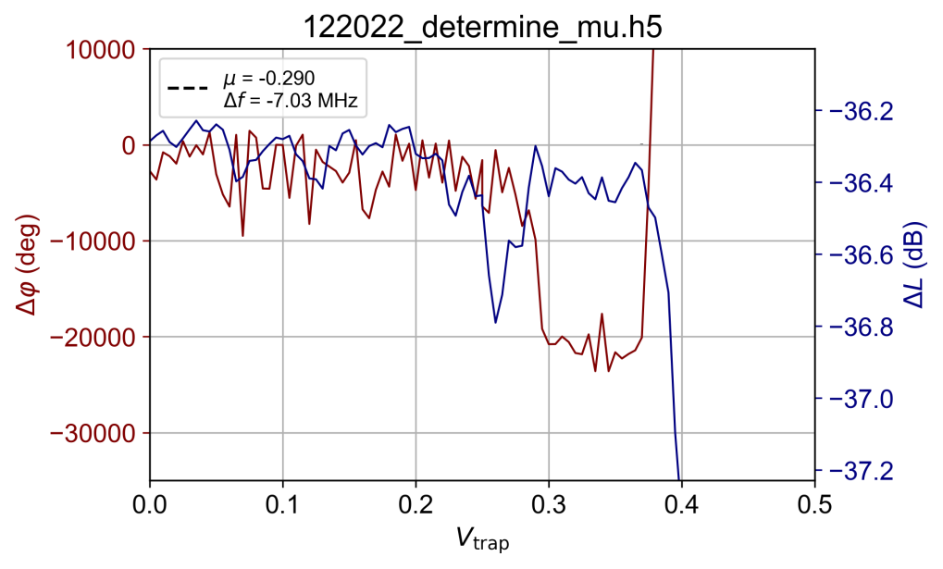
Area covered in this 2D sweep
Plots shown on next slides are 2D sweeps where successively go lower in Vtrap, starting at 0.25 and going to 0.10 V in steps of 0.01 V. Note that the axes are not voltage, but sweep points to keep the first part of the sweep visible (otherwise that part would fall on a single line. I find this better interpretable).
The first part of the sweep consist of sweeping the resonator guard more negative and is to the left of the black dashed line in each plot.
Pay attention to how the color contrast (max – min) of the colorbar (particularly delta f) slowly decrease as we step down the trap voltage. For 0.25 – 0.23 it’s about 30 kHz contrast and for all other traces it goes down to < 20 kHz. My hypothesis is that we only have electrons starting at around 0.25V, i.e. the range I covered in this experiment is too low.

Slide 2
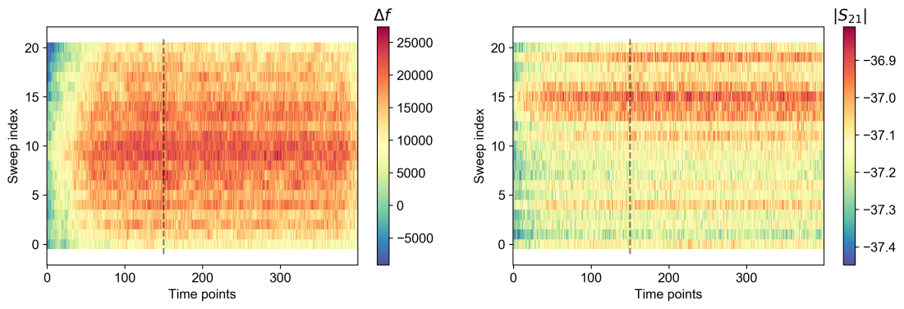
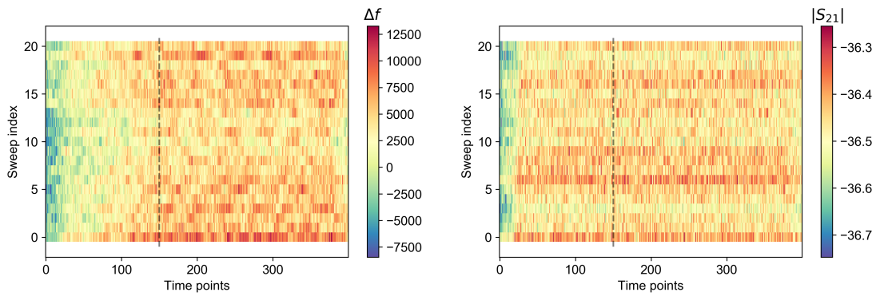
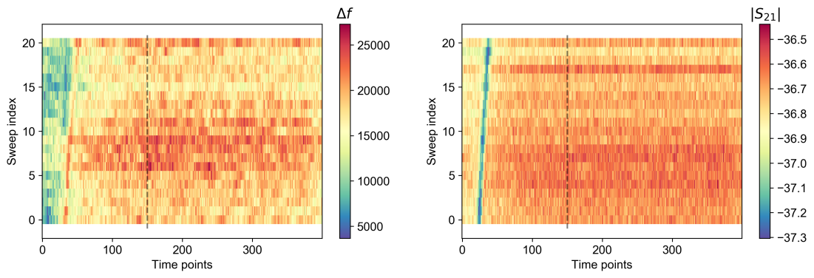
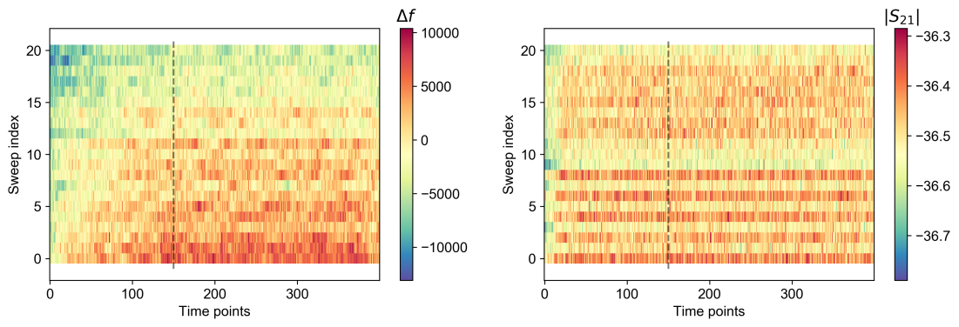
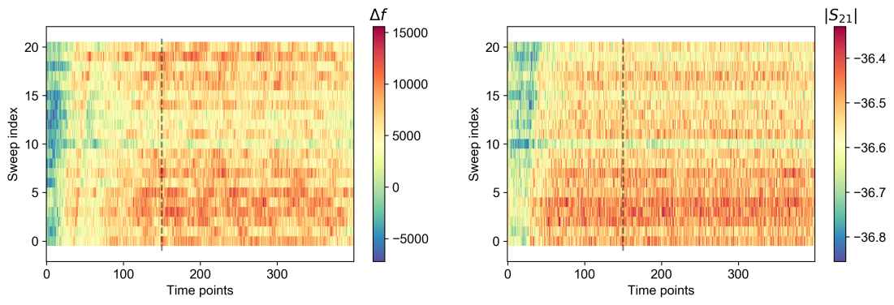
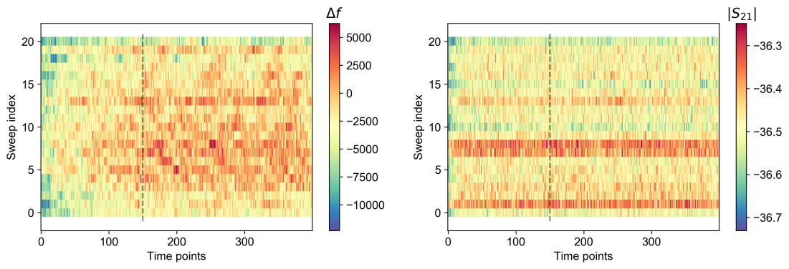
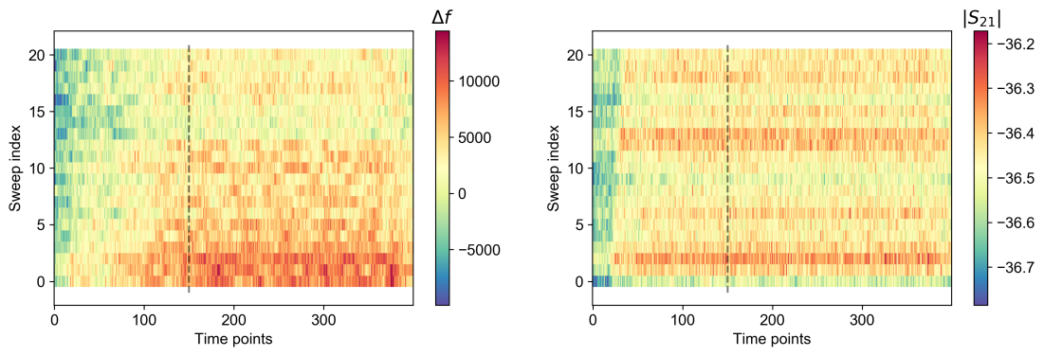
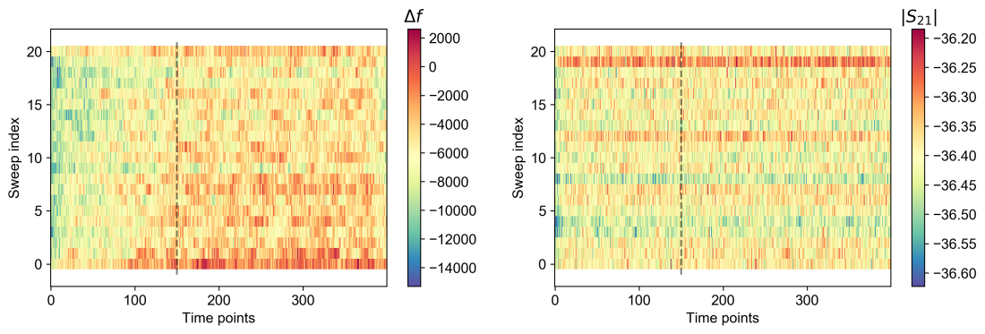
0.25
0.21
0.22
0.18

Slide 3
